Slide 1
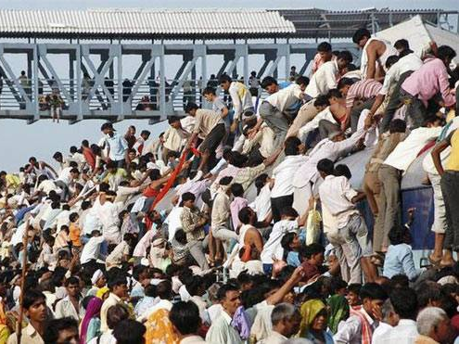
BES166=> HRD: Today’s Topics
Census
Edu. Policy 2016
Health-Women, Children
HDI-2015 | SDG

Slide 2


Slide 3

Origin and Themes
HDR
1990, Mahbub ul Haq (Pak), Amartya Sen (India)
2013: Rise of the South: Human Progress in a Diverse World
2014: Sustaining Human Progress: Reducing Vulnerability and Building Resilience
2015: Work for Human Development

Slide 4

Theme: “Work” for human development
Why?
Work is intrinsic to H.D.
“Work” is deeper than “employment” care work, voluntary work, writing or painting = essential for HD.
Material well being
Male: Defines manhood
Female: Sense of dignity
Both: Place in society, Social cohesion
Challenges?
Work | HD = synergy BUT Begari, child labour, Unpaid work of women ??
Individually work is productive but what if not sustainable? (e.g. mining, logging, fishing)
Worker’s rights-safety-well being? (silicosis, asbestosis)
Fruits of Digital age & new millennium: unequally distributed
Essay points- read and ruminate

Slide 5
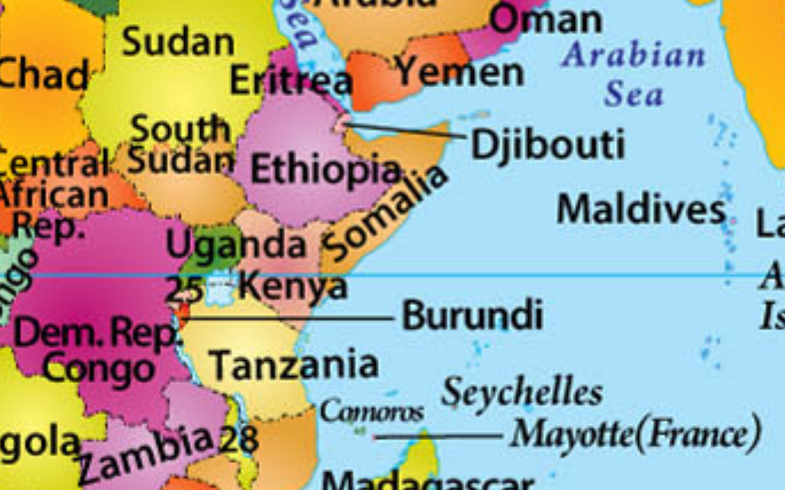
UNDP HDR-2015: Addis Ababa, Ethiopia
Which of the following is not a landlocked country?

Slide 6

UNDP HDR-2015: 5 indexes
HDI
HDI-inequality adj. (IHDI)
Gender Dev. (GDI)
Poverty Multidim. (MPI)
Gender Inequality (GII)
Notes:
Human Development Index (HDI)
the Inequality-Adjusted Human Development Index (IHDI)
Gender Development Index (GDI)
Gender Inequality Index (GII)
Multidimensional Poverty Index (MPI)

Slide 7
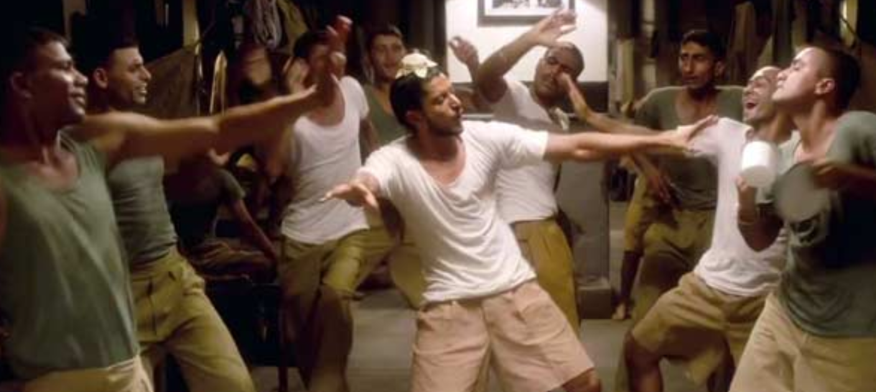
How to measure Human develpment?
Paidaa Hotaa
Padhtaa
Paise Kamata
to live a long and healthy life
to be educated and knowledgeable
to enjoy a decent economic standard of living.

Slide 8

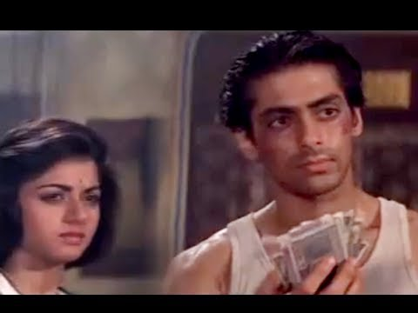

Paidaa Hotaa
Padhtaa
Paise Kamata
Expected years of schooling: 11.7
Life expectancy @Birth
68 years
GNI per capita (PPP-2011)
$5497
Mean years of schooling: 5.4
G.M=Cube root = HDI-2015 = 0.609

Slide 9
HDI-2015
Very high (>0.8-1.0)
High: (>0.7- 0.8)
Sri Lanka, Brazil, China
Norway, Australia, Swz, Den, Neth
Medium: >0.550-0.700
India: 135(2014)=>130(2015)
Low
Nepal, Pak, Myan…..188th Niger
Bhutan,…Bangladesh

Slide 10
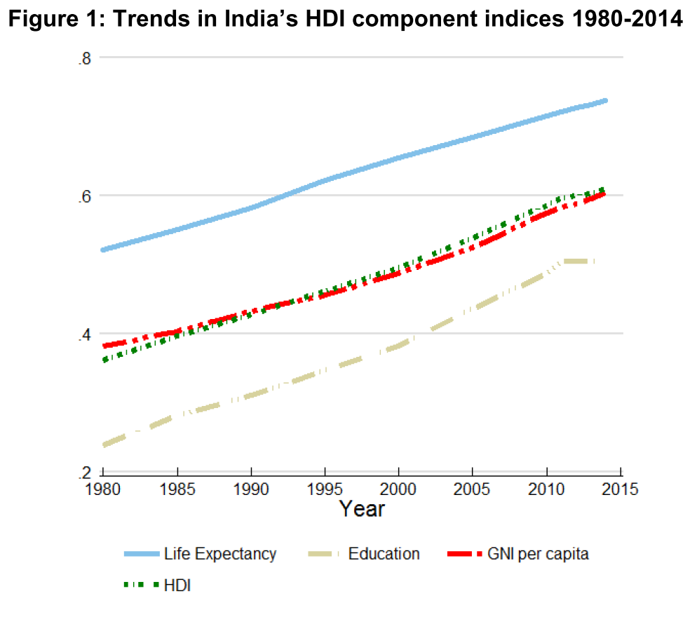
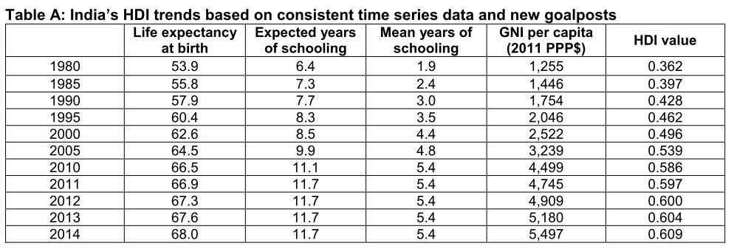
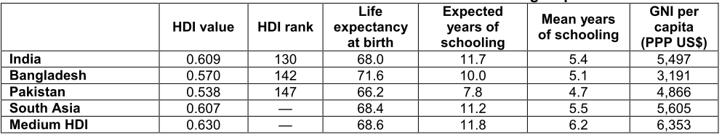
Jobless service sector growth = $$
Education not improving as quickly

Slide 11
UNDP HDR-2015: 5 indexes
HDI
HDI-inequality adj. (IHDI)
Gender Dev. (GDI)
Poverty Multidim. (MPI)
Gender Inequality (GII)
Notes:
Human Development Index (HDI)
the Inequality-Adjusted Human Development Index (IHDI)
Gender Development Index (GDI)
Gender Inequality Index (GII)
Multidimensional Poverty Index (MPI)

Slide 12
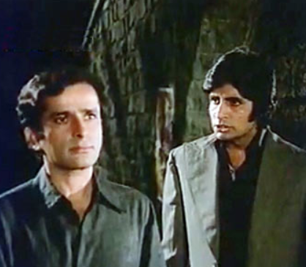
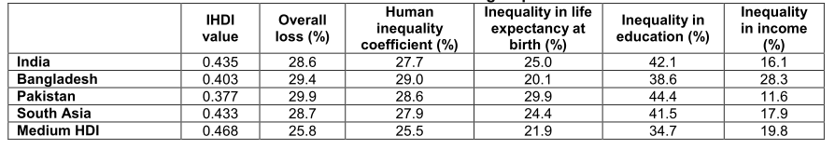
Inequality adjusted
Indicator#2
HDI: Geometric mean; masks internal inequality
Loss in HD= (HDI: 0.609- Inequality adjusted HDI:0.435) –
India’s Ranking: HDI +1

Slide 13
UNDP HDR-2015: 5 indexes
HDI
HDI-inequality adj. (IHDI)
Gender Dev. (GDI)
Poverty Multidim. (MPI)
Gender Inequality (GII)
Notes:
Human Development Index (HDI)
the Inequality-Adjusted Human Development Index (IHDI)
Gender Development Index (GDI)
Gender Inequality Index (GII)
Multidimensional Poverty Index (MPI)

Slide 14

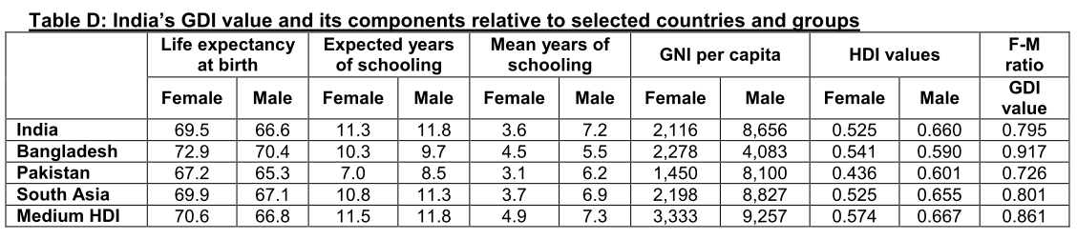
Gender Development Index
Indictor#3
= Female HDI/ Male HDI
Estonia (1.030); Latvia, Russia etc. >1
less than 1=bad
Sweden (0.999)
Norway (0.996)
….
India (0.795)

Slide 15
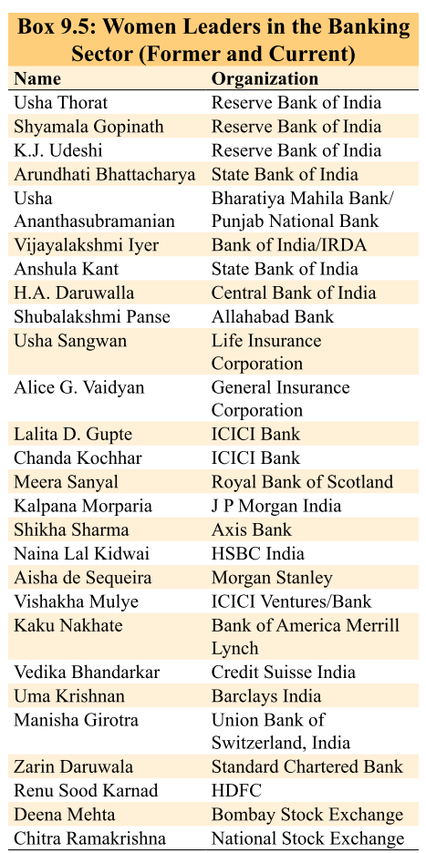
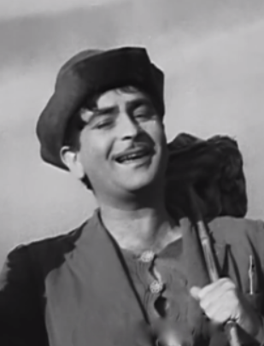
Indicator#3: GDI
1: BEST
2
3
4
5: Most Bogus e.g. India

Slide 16
UNDP HDR-2015: 5 indexes
HDI
HDI-inequality adj. (IHDI)
Gender Dev. (GDI)
Poverty Multidim. (MPI)
Gender Inequality (GII)
Notes:
Human Development Index (HDI)
the Inequality-Adjusted Human Development Index (IHDI)
Gender Development Index (GDI)
Gender Inequality Index (GII)
Multidimensional Poverty Index (MPI)

Slide 17
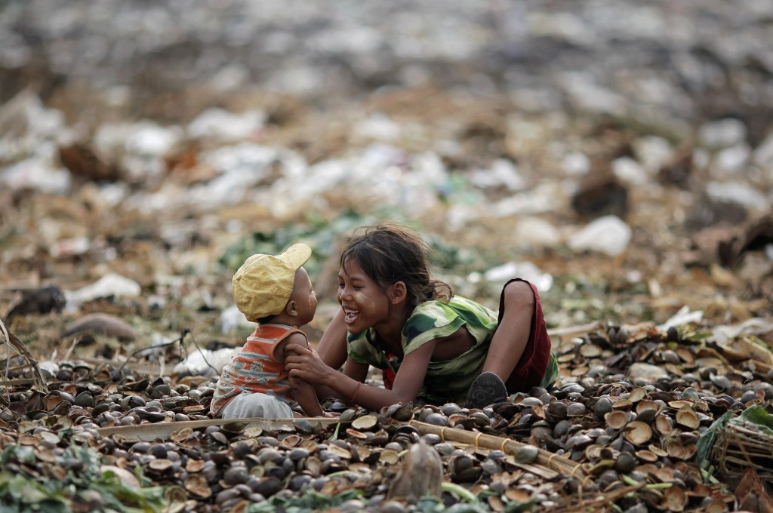
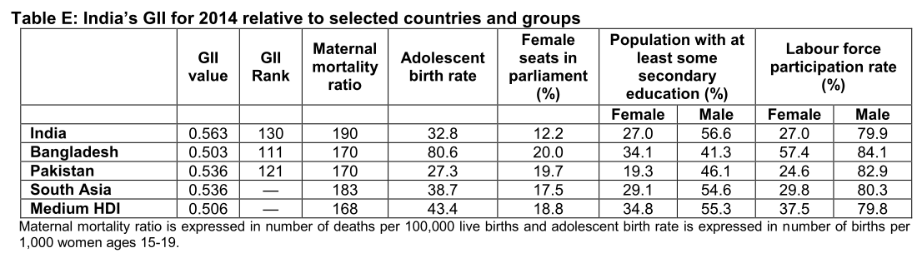
Indicator#4: Gender Inequality index (GII), since 2010
GII for India
Reproductive Health
M.M.Rate: 190/1 lakh live birth
Adolescent Birth rate (15-19): 33/1000
Empowerment
Parliament seats: 12.2%
Atleast HSC: 27%
Economic Activity
Labor force participation: 27%

Slide 18
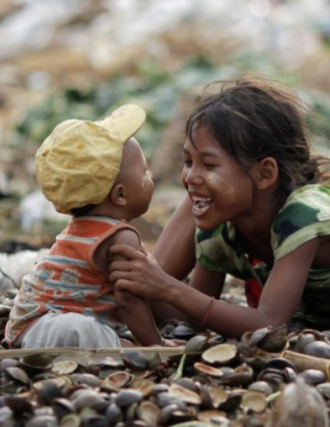
GII 0= none 1= max.
Indicator#4
1st: Slovenia (0.016)
….
130th : India (0.0563)
155th: Yemen (0.744) most bogus
Not all countries have data to produce GII

Slide 19
UNDP HDR-2015: 5 indexes
HDI
HDI-inequality adj. (IHDI)
Gender Dev. (GDI)
Poverty Multidim. (MPI)
Gender Inequality (GII)
Notes:
Human Development Index (HDI)
the Inequality-Adjusted Human Development Index (IHDI)
Gender Development Index (GDI)
Gender Inequality Index (GII)
Multidimensional Poverty Index (MPI)

Slide 20
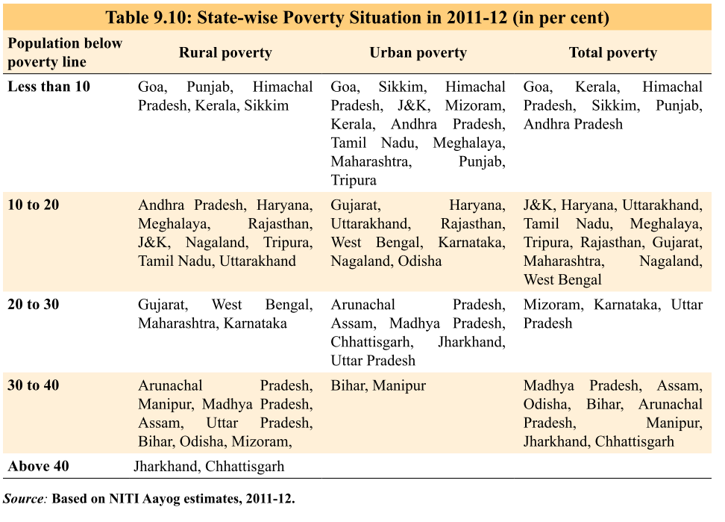
Poverty : DESHI method (Article | SECC-Video)
Tendulkar Committee methodology
using household consumption expenditure
survey data collected by the NSSO in its 68th round (2011-12)

Slide 21
Indicator#5: Multidim. Poverty Index, since 2010
Incidence
Health
Intensity
How many indicators does household lack?
Education
Std. of Living
MPI
Poverty Line ($1.25)
India’s 31.7% junta gareeb
MPI
55.3% Junta gareeb
$ alone not cure for deprivation

Slide 22
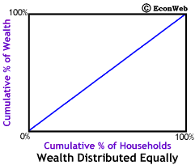
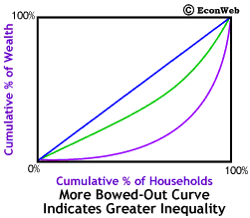
Gini coefficient
poorest 30% own only 2% of nation's wealth
richest 10% own 50% of nation's wealth

Slide 23
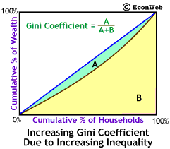
Italian statistician Corrado Gini (1912)
0= equal | 1= most unequal
X 100= %: India: 33.4% (World Bank publishes)
Notes:
In India, income inequality is lower than USA, as per Gini Coefficient.
It’s a purely mathematical measure of inequality within a population
All correct
World Bank publishes Gini Coefficient
Gini Coefficient is an internationally accepted measure of income inequality
Higher the Gini Coefficient, lower the inequality

Slide 24
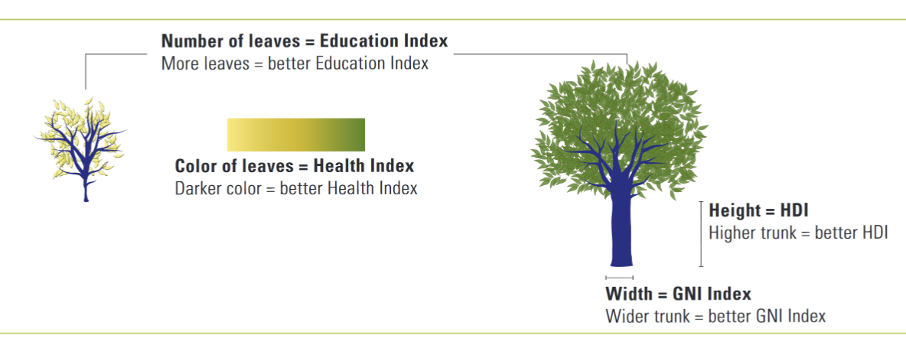

Slide 25
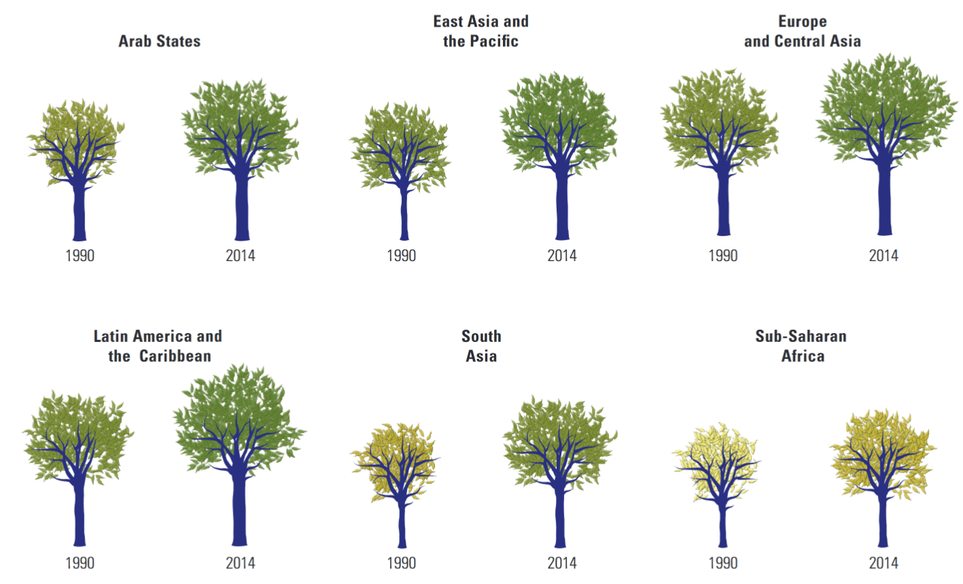

Slide 26
MDG and SDG
2000
MDG framed
UNGA
2015
Deadline
MDG
1992
Earth Summit Rio
2012
Rio+20
2015, Sep
17 SDG adopted
2030
SDG Deadline
SDG
Notes:
2015: millennium Development goals will expire.
Therefore, under RIO+20 summit, the leaders had decided to enact new “Sustainable development goals” (SDG)
UN general assembly has setup 30 member group to design SDG.

Slide 27
MDG vs SDG
Detail
Goal
Associated targets
MDG
8
18
SDG
17
169
Deadline
2015
2030
Adopted @ United Nations Development Programme (UNDP)
New Year Summit 2015, Sep.

Slide 28
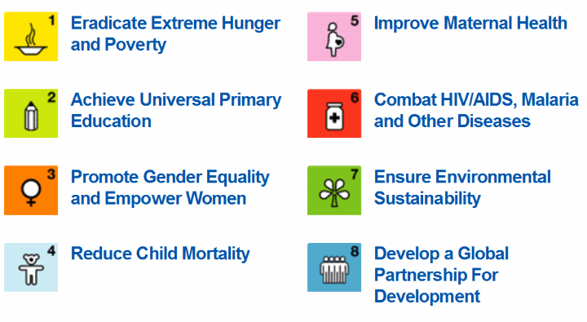
Millennium Development goals (MDG)

Slide 29
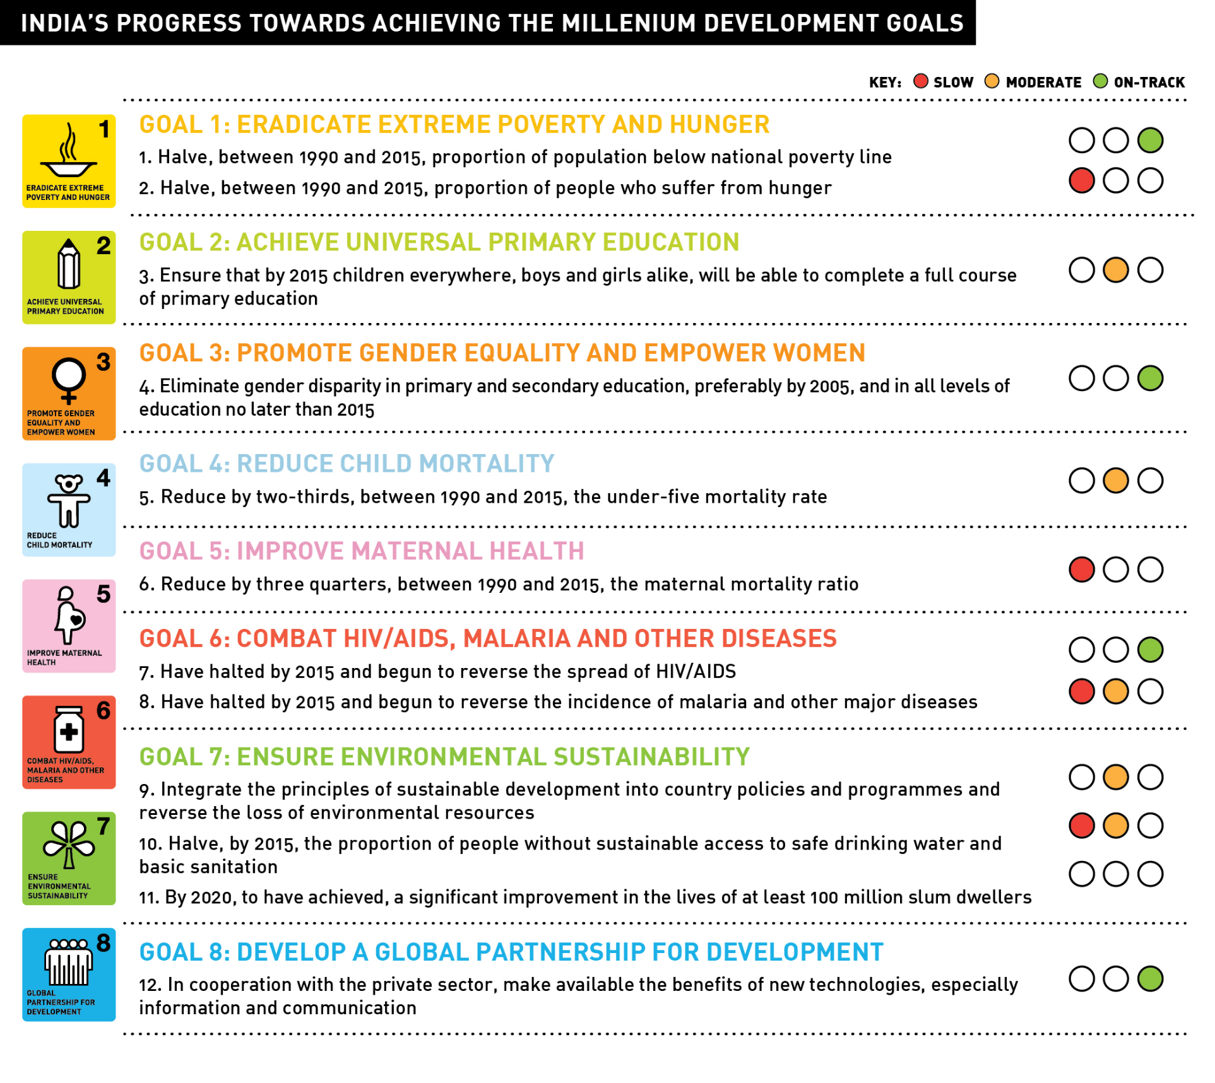

Slide 30
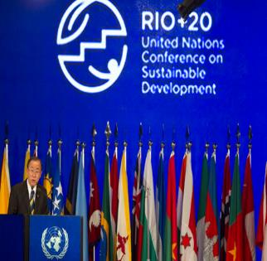
What is sustainable Development?
SDG
Development which meets the needs of current generations without compromising the ability of future generations to meet their own needs
Brundtland commission on World Commission on Environment and Development (1987) gave above definition

Slide 31
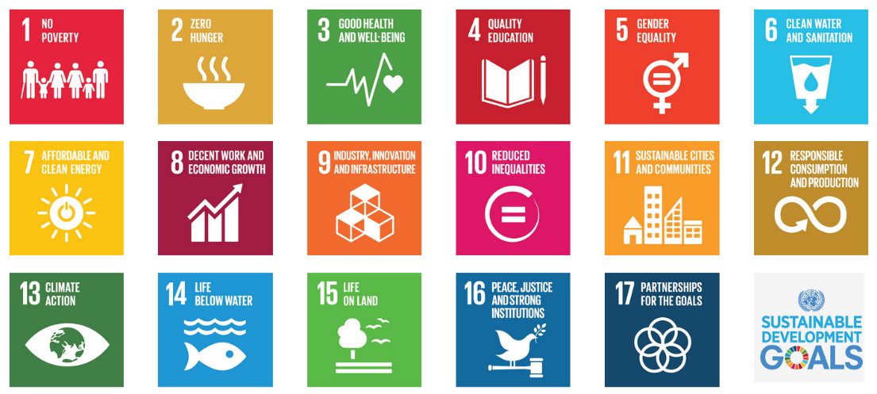
17 SDG Goals | 169 Targets- from 1st Jan’16-2030

Slide 32
17 SDG=Roti-city-bi-pa-sa-(p6)
Roti khata
Bijli
Sadak
Pani
Roti bigaadtaa
City

Slide 33
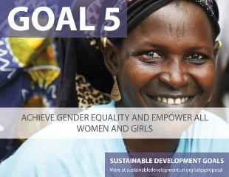
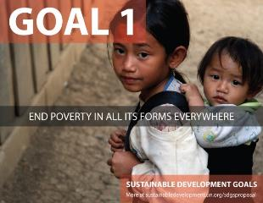
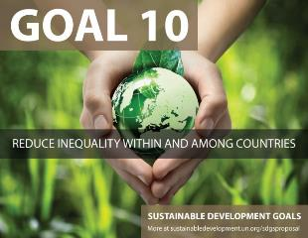
17 SDG=roti-city-bi-pa-sa-(p6)
Paida hota
Padhtaa
Paise Kamata
Kucch
Ling gareeb
Log gareeb
Desh gareeb

Slide 34
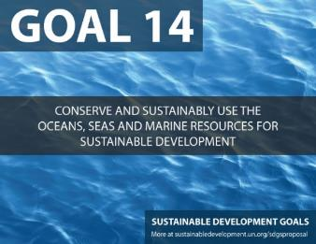
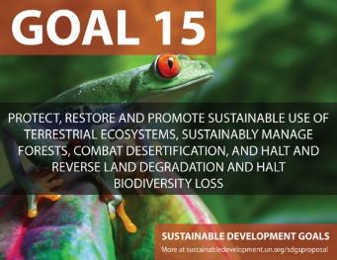
17 SDG=Roti-city-bi-pa-sa-(p6)
Paryavaran Bigadtaa
Police mein jaata
Partnership karta
Harming environment
1.@Sea
2.@Land

Slide 35
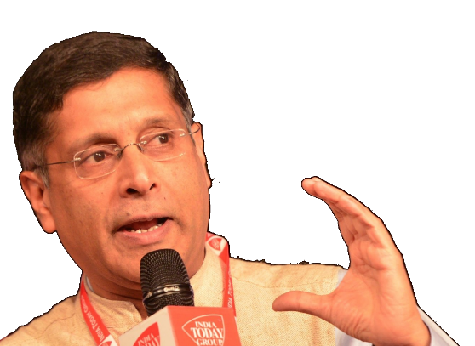

Survey
SDG Criticism
Difficult to monitor
Need more finance- have to tap public + private finance (desi+videshi)
India will have to 'prioritize' Because difficult to target each goal.
Notes:
The SDGs are effective from January 2016 and will end in 2030.

Slide 36
SDG
Rashtriya Gram Swaraj Abhiyan,
655 cr. to improve governance strucuture of PRIs for SDG
Budget 2016

Slide 37

SDG SLIDES AFTER THIS POINT
You may ignore slides after this….for prelims
Because cost benefit : little
But do refer for mains/interview.

Slide 38

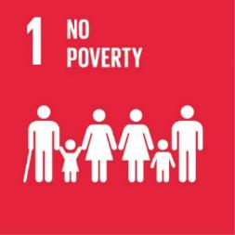
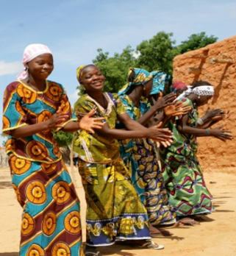

Slide 39
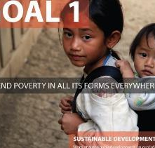
Remove/reduce
Eradicate extreme poverty (<1.25$/per day) by 2030
Reduce 50% of poor population (by national definition of poverty)
How?
National social protection system (MNREGA, Pension,Bima)
Give microfinance, land/asset ownership, other Gender sensitive policy measures.
Bolbachchan
Encourage investment
Help LDC and small island nations.
>800 million live on <1.25$/day
Child mortality, migration, crime-extremism, low-HDI

Slide 40
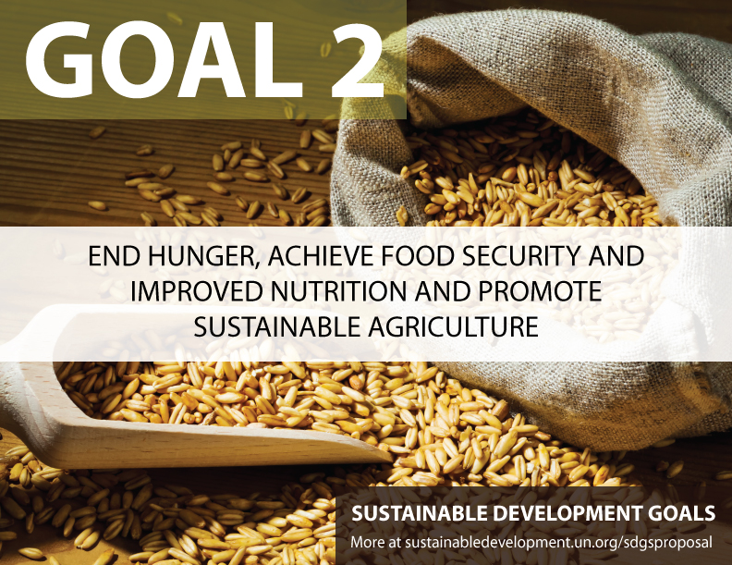
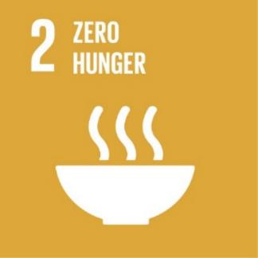
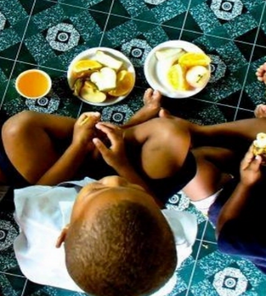

Slide 41

By 2025: intl. agreed targets for under-5 malnutrition
End hunger, malnutrition- focus on infants, females, aged
2030: 2x agro productivity.
By 2020: work for genetic diversity of plant, animal ▲investment in R&D, extension services; gene banks
▼ volatility in domestic commodity markets
Correct intl. agro. Trade barriers, remove agro-export subsidies (WTO-food-secu. peace clause already asked)
Malnutrition ▼karo
Production ▲karo
Selling
1 in 4 kids undernourished. Hunger => 45% of under-5 deaths
1 in 9 people undernourished (795 mil.) => +2 billion by 2050; 2/3rd of Hungry in Asia
40% Population agro depend; 80% food comes from small rainfed farms.
soils, freshwater, oceans, forests, biodiversity degraded
food insecu+migration

Slide 42


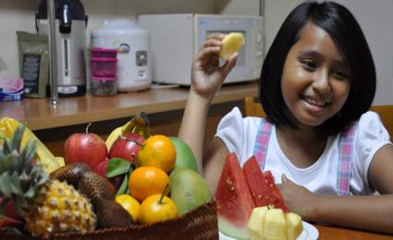

Slide 43

MMR|CMR (2030
Neonatal: 12/1000
Under-5: 25/1000
MMR:70/1 lakh
Family planning
Universal access to info., services, sex-education
Mother & Child
Improvement over 1990 but,
Under-5: Poor kid=2x rich kid
MMR: 3rd world = 14x 1st world
Health service: 50% mothers in 3rd world
Notes:
Child health
17,000 fewer children die each day than in 1990, but more than six million children still die before their fifth birthday each year
Since 2000, measles vaccines have averted nearly 15.6 million deaths
Despite determined global progress, an increasing proportion of child deaths are in sub-Saharan Africa and Southern Asia. Four out of every five deaths of children under age five occur in these regions.
Children born into poverty are almost twice as likely to die before the age of five as those from wealthier families.
Children of educated mothers—even mothers with only primary schooling—are more likely to survive than children of mothers with no education.
Maternal health
Maternal mortality has fallen by almost 50 per cent since 1990
In Eastern Asia, Northern Africa and Southern Asia, maternal mortality has declined by around two-thirds
But maternal mortality ratio – the proportion of mothers that do not survive childbirth compared to those who do – in developing regions is still 14 times higher than in the developed regions
More women are receiving antenatal care. In developing regions, antenatal care increased from 65 per cent in 1990 to 83 per cent in 2012
Only half of women in developing regions receive the recommended amount of health care they need
Fewer teens are having children in most developing regions, but progress has slowed. The large increase in contraceptive use in the 1990s was not matched in the 2000s
The need for family planning is slowly being met for more women, but demand is increasing at a rapid pace

Slide 44
Epidemics
end the epidemics of AIDS, tuberculosis, malaria and neglected tropical diseases
combat hepatitis, water-borne diseases and other communicable diseases
Policy / nationwide
Early warning of global health risk (e.g. SARS, Ebola)
Healthworker: increase no. & training
Universal healthcare coverage
AIDS, TB etc.
Rate of HIV, Malaria reduced
HIV leading cause of women-death
2nd most common cause of adolescent girl death
Notes:
Child health
17,000 fewer children die each day than in 1990, but more than six million children still die before their fifth birthday each year
Since 2000, measles vaccines have averted nearly 15.6 million deaths
Despite determined global progress, an increasing proportion of child deaths are in sub-Saharan Africa and Southern Asia. Four out of every five deaths of children under age five occur in these regions.
Children born into poverty are almost twice as likely to die before the age of five as those from wealthier families.
Children of educated mothers—even mothers with only primary schooling—are more likely to survive than children of mothers with no education.
Maternal health
Maternal mortality has fallen by almost 50 per cent since 1990
In Eastern Asia, Northern Africa and Southern Asia, maternal mortality has declined by around two-thirds
But maternal mortality ratio – the proportion of mothers that do not survive childbirth compared to those who do – in developing regions is still 14 times higher than in the developed regions
More women are receiving antenatal care. In developing regions, antenatal care increased from 65 per cent in 1990 to 83 per cent in 2012
Only half of women in developing regions receive the recommended amount of health care they need
Fewer teens are having children in most developing regions, but progress has slowed. The large increase in contraceptive use in the 1990s was not matched in the 2000s
The need for family planning is slowly being met for more women, but demand is increasing at a rapid pace

Slide 45


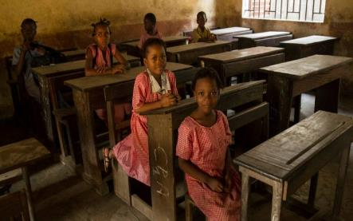

Slide 46

Whom to Teach?
Who will teach and where?
Improve Teacher, Building, Learning modules
Free, equitable, quality pri. & sec. Edu. To boys and girls
Adult literacy: esp. women: primary pass mother’s child 2x likely to survive than illiterate mom;
Help L.D.C & small island nations
What to teach?
Value edu- global citizenship, non-violence, gender/culture sensitivity, women rights, appreciating diversity
Vocational entrp. Skill training
PH, child in conflict (juvies)
91% enrolment in primary schools of 3rd world
But 6 crore kids still out- 50% of them in conflict areas
>10 crore illiterate, >60% of them women
Notes:
Child health
17,000 fewer children die each day than in 1990, but more than six million children still die before their fifth birthday each year
Since 2000, measles vaccines have averted nearly 15.6 million deaths
Despite determined global progress, an increasing proportion of child deaths are in sub-Saharan Africa and Southern Asia. Four out of every five deaths of children under age five occur in these regions.
Children born into poverty are almost twice as likely to die before the age of five as those from wealthier families.
Children of educated mothers—even mothers with only primary schooling—are more likely to survive than children of mothers with no education.
Maternal health
Maternal mortality has fallen by almost 50 per cent since 1990
In Eastern Asia, Northern Africa and Southern Asia, maternal mortality has declined by around two-thirds
But maternal mortality ratio – the proportion of mothers that do not survive childbirth compared to those who do – in developing regions is still 14 times higher than in the developed regions
More women are receiving antenatal care. In developing regions, antenatal care increased from 65 per cent in 1990 to 83 per cent in 2012
Only half of women in developing regions receive the recommended amount of health care they need
Fewer teens are having children in most developing regions, but progress has slowed. The large increase in contraceptive use in the 1990s was not matched in the 2000s
The need for family planning is slowly being met for more women, but demand is increasing at a rapid pace

Slide 47


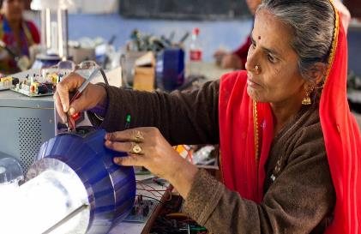

Slide 48
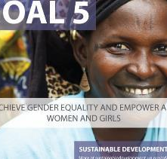
Stop
Unpaid work
All forms of violence, Trafficking
Forced /Child marriage, female genital mutilation
Recognize role in child-care, domestic work
Promote “Shared responsibility”
Participation
Land/asset ownership rights, inheritance laws
Family planning, reproductive health (Beijing platform)
Political partition- ICT/legislation
Gender parity in education, legislature, job improved
But barriers in school, non-agri. Jobs.

Slide 49
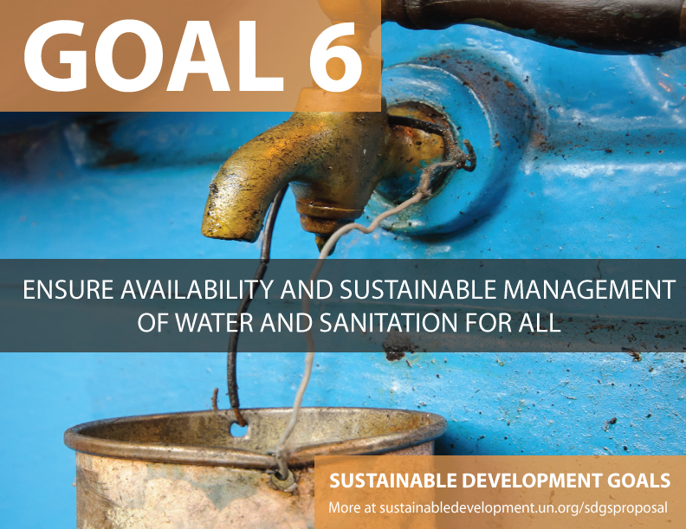

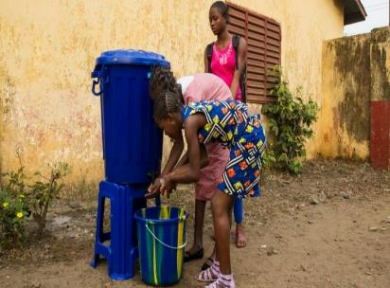

Slide 50
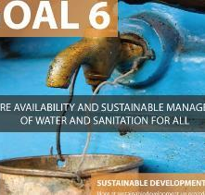
Provide water
safe and affordable drinking
universal and equitable access
Manage
integrated water resources management- trans-national
Local community participation
water-related ecosystems: protect and restore- mountain, forest, river, lakes
Stop / reduce
Open defecation esp. females
Release o chemicals/waster water in rivers/lakes/sea
1k children die per day on diarrhoea, water-diseases
>65% people without easy access 2drinking
70% of water used irrigation
70% death from floods
80% untreated to river

Slide 51

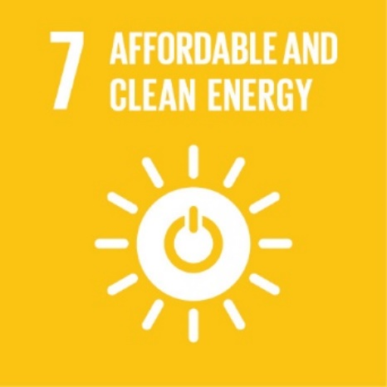
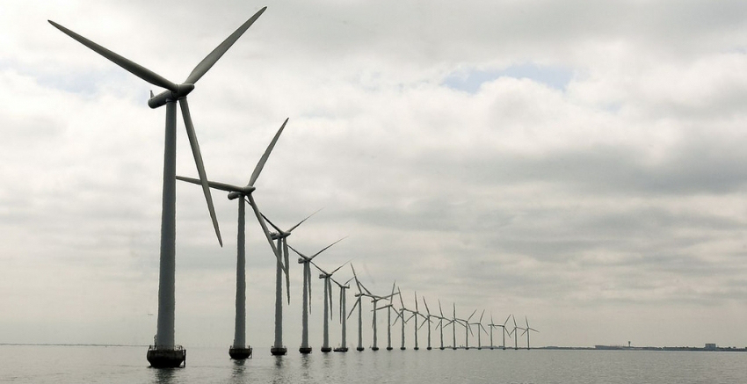

Slide 52
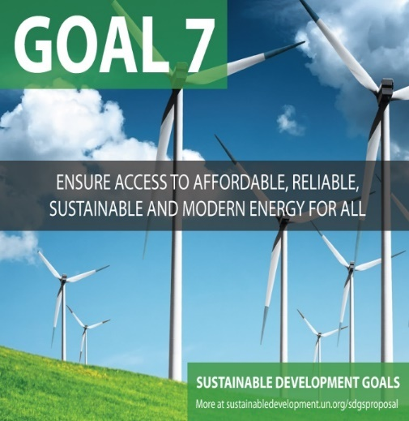
affordable, reliable and modern energy to all (universal, both gender)
Increase share of renewable energy in the global energy mix
2x energy efficiency rate
Energy to all
Clean energy
efficient
1 in 5 no electricity
3 billion rely on wood, coal, charcoal or dungs
60% GHG comes from energy

Slide 53
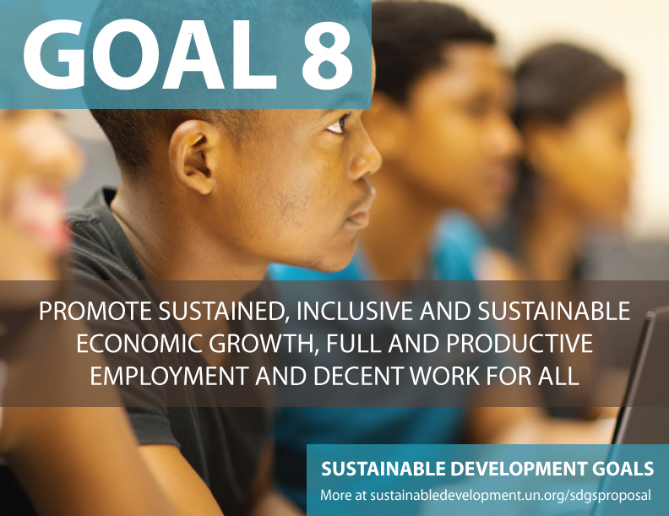

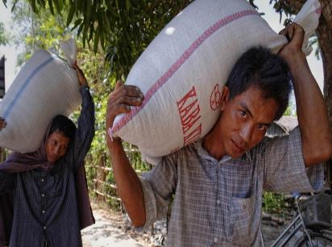

Slide 54
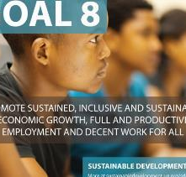
L.D.C, intl. cooperation
Min.7% GDP growth rate in L.D.C
Promote
Innovation, Entrepreneurship
MSME, Tourism
Give
Equal pay for equal work
Productive Jobs to all (men, women, PH)
Eliminate / protection
LDC: Intl. cooperation, tech transfer, trade help
Forced Labour
Child Labour, child soldiers
Financial inclusion-Banking, finance, insurance services
Safety of women labour/migrants
ILO-job pact implement; human trafficking
unemployment ▲
>220 cr. Live <2$/day
>20cr. Unemployed
~50 cr. Workers needed

Slide 55




Slide 56

Agro
3rd world: 30% processed; 1st World: 98%
Mfg.
1 job in mfg = 2.2 jobs in other sectors
World wide 0.5 billion in mfg.
By 2030: mfg/industrial sector’s contribution- 50% in gDP
Agri.business/ Food processing
infra
Develop infra. Necessary for eco+human Dvlp
Regional, trans border level
2020: universal-affordable Internet to L.D.C.
Millions don’t have road, ICT, sanitation, electricity
Undeveloped infra: market access, health, edu. suffer

Slide 57




Slide 58

bottom 40%’s income growth make higher than national
Inclusion
social, economic and political inclusion of all
irrespective of age, sex, disability, race, ethnicity, origin, religion or economic or other status
Migrant Remittance cost: <3%
Eliminate remittance corridors with 5% or higher cost
Migration
Faster Development of bottom strata
New fiscal, wage, social protection policy and laws for
Encourage FDI to LDC, Landlocked 3rd world, Small island
Migration policy-safe, responsible
Give Special treatment to them in WTO
Income inequality ▲ than 1990
Poorest 20% pop: under-5 death 3x than rich
Rural preg. 3x death chances than urban

Slide 59




Slide 60

Give
Universal Housing, transport (PH, women)
safeguard culture, heritage
Reduce
Pollution, waste, litter
Link
Green public spaces
Urban => per-urban =>rural
Linkage: economical, social, environmental
Disaster vulnerability: Sendai Framework 2015-2030
50% world pop in cities (60%by 2030)
Area 3%; 60% energy; 75% GHG
Water, sewage, health problem
>80 cr in slums

Slide 61




Slide 62

Food wastage
Per capita food waste: reduce by 50% (focus on post-harvest, supply chain)
Pollution
3 bn tonne wasted while 1 bn hungry, 1 bn malnourished
Chemical Management- intl. framework implement
Waste: prevent, reduce, recycle, reuse
Promote
Sci-tech for sustainable use of natural resources
Sustainable tourism – create jobs , preserve culture-environment
>30% car increase in next 5 yeas=> must reduce fissile fuel subsidies
1/3rd food rotten- poor transport, storage, processing
3% water drinkable- 2.5% frozen
CO2: 21% household; 30% food
2050: 3 planets required to sustain lifestyle

Slide 63




Slide 64

$100 billion by 2020
1st world to give this much in UN Framework convention on climate change (UNFCCC)
Focus
Small island nation, L.D.C
Women and marginalized communities
Adopt
Policies, planning
Education, awareness
Mitigation + Adaptation
1 Degree rise=> agro yield ▼ by 5%
C02 Emission increased by 50% since 1990
Over 1 mil. Sqkm ice loss from Arctic every decade=>sea level rise

Slide 65




Slide 66

Minimize
Ocean acidification
Intl. bol bachchan
Marine pollution
Unregulated / destructive fishing practices
Stop
Fishing subsidies that promote overfishing
Help small island nations, L.D.C
Implement UNCLOS for use of ocean resources
97% surface occupy, give livelihood to 3 billion people, 5% of global GDP
Largest source of protein, >200 mil. Employed in fisheries
But subsidies = depletion, habitat loss
Notes:
United Nations Convention on the Law of the Sea

Slide 67




Slide 68

Stop / reduce
Desertification
Poaching =by giving sustainable livelihood.
Alien species invasion
Restore
Inland fresh water ecosystem
Biodiversity by stopping further extinction of species
Intl. bolbachchan
Cooperation against illegal trade in wildlife
$$ to 3rd world to restore forest/ degraded land
Forest home to 80% terrestrial plant/animal/insects.
80% rural junta depend on medicinal plants from forest, But we know ~1% of forest plant’s medicinal use.
1.5 billion affected by land degradation,
23 ht. land lost per minute by drought & desertification

Slide 69




Slide 70

Reduce /stop
Violence, torture, trafficking esp. against children
Local people in local administration
Illegal weapons trade
Corruption
Increase participation of
3rd world in intl. governance, crime-terrorism treaties
Provide
Birth registration and Legal identity to all, by 2030
Freedom of information to all (RTI)
Judiciary + police most affected by corruption
Corruption = >1 trillion cost to 3rd world
50% out of school kids are in conflict areas

Slide 71




Slide 72

Finance / funding / investment in 3rd world
Reduce Debt distress of 3rd world through Debt structuring
International Trading
investment promotion
Non-discrimination, rule based intl. trade system with minimal tariff and non tariff barriers (WTO)
Bring macro-economic stabilization (subprime, China stock crash, Greece debt)- systematic coordination necessary
Tech transfer
North South, South South
Sci, tech, innovation, ICT
Duty free quota free access
Development funding increased.
But 30% of youth has internet access
90% of people without internet live in 3rd world.

Slide 73


SDG
Positive
Negative

Slide 74
Harmonized: Growth + env. protection +inclusion
Kyoto: GHG; Hyogo/Sendai: Disaster
WTO: Trade; IMF: BoP
SDG covering all these
World Bank: poverty; Beijing: Women

Slide 75
Positive points
No Discord
All nations adopted. No discord as in Kyoto (USA, Canada left) and WTO Trade facilitation Agreement (India- peace clause)
Even emerging economies will play “Donor”.
Acknowledged the role of private sector and civil society.
Talked about sustainable consumption, reducing food waste, justice for all
First Time
“hope”
in the troubled times @Africa, Middle-East

Slide 76

1st World not doing enough
SDG-Criticism
Bol-bachchan about helping small island nations
But ocean water rise => climate refugees=> who will accommodate when Syrian refugees denied safe entry in EU
Means of implementation ($$) missing. World needs ~5 Trillion $$ each year- Richer nations have to bear more.

Slide 77

Target monitoring & accountability
Criticism
Too many goals (17) & Targets (169)
Difficult to monitor, report, hold Government accountable
Data inconsistency: India- # of poors, illiterate, unorganized workers differ in SECC vs. NSSO)
DATA deficit: 12th FYP had 25 indicators but data unavailable, then how to cover 169? (Niti Ayog CEO Sindhushree Khullar)
Data Fudging / manipulation: official stat.say India close to meet MDG targets on IMR/MMR, Lancelet says otherwise.
Counter: UN Statistical Commission will finalize, chief statisticians meeting

Slide 78

Indian “Schemes” need revamp
Political exclusion: urban poor, migrants, hawkers, unorganized workers.
ill-planned priority: Focused Family planning=> MMR, IMR high.
Ignored the Cognitive tax and social tax aspect of poverty.
Subsidies: Leakage, Distortion, error in beneficiary selection.

Slide 79

India’s financial capacity to meet SDG?
Criticism
India couldn’t even achieve all MDG due to resource shortage
External aid + CSR + tax = 5% of total money required for SDG in India
Must improve tax: GDP ratio (17% right now), implement GST, stop black money, corruption, subsidy leakage

Slide 80

Overall Criticism
SDG
Technical “Standard operating procedure” missing
Funding guidelines missing.
Mere spelling out truism & platitude (obvious truth).
“Hope”=> Disenchant.

Slide 81

BES166=> HRD: Today’s Topics
Census
Edu. Policy 2016
Health-Women, Children
HDI-2015 | SDG

Slide 82

Theory +Economic Survey Vol.2 + Vol.1 + Budget 2016
1.Banking Finance
6.HRD
2.Budget-Fiscal Policy
3.BoP
4.Sectors of Economy
5.Infra
V2C2-Pub.Fin; V1C3-JAM
V2C3-Monetary mgmt+FI
V2C4-External sector
V2C5-Price,Agri.; V2C6,7
V2C8-Paris Summit, Energy
V2C9-Social infra.
V1C4-Agri ; V1C9-Fertilizer
V1C5-mother-child
V1C6-bounties; V1C7-Fiscal Cap
V1C8-PTA
V1C2-Chakravy; V1C10-Labour
V1C11-Powering 1 India
B1. Financial Sector Reforms
B2. Fiscal Discipline
B3. Tax Reforms; B4. Ease of
B5. Agro: 2x farmer income
B6. Rural infra-employment
B7. Infrastructure
B8. Social Sector & healthcare
B9. Education, Skills, Jobs
V2C1- Chakravyuh challenge
V1C1- Twin Balancesheet
IYB:7-Commerce
Nashta, Exampad,
Pass: DAF- hobby, cadre,
Whole night before prelims…X
Fail: IBPS, RBI, SSC, CAPF…
Any case: IGNOU PG
Best wishes to all serious players

